Slide 1
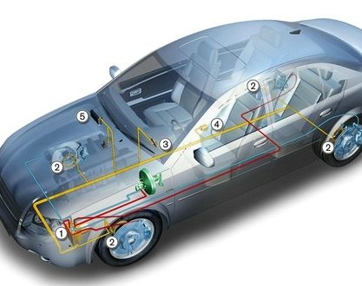
1. Title and Overview
Securing In-Vehicle Networks: A Post-Quantum and Federated Learning Architecture
Overview
This project proposes a segmented CAN-FD architecture that integrates Post-Quantum Cryptography and machine learning.
It utilizes hardware-rooted identity and ML-DSA for remote ECU attestation.
The system transfers massive post-quantum payloads using a custom 60/4 indexed block-transfer mechanism over CAN-FD.
It implements a Federated Learning-based Intrusion Detection System at the Gateway to detect anomalies locally.
Team-
Kaustuv Bhattacharjee 23BDS1060
Kunal Singh Dadhwal 23BDS1097
Tapan Batla 23BDS1151
01 / 10

Slide 2
2. Motivatiion
Research Motivation
With the age of autonomous fleets, we will see more and more vehicles which will have little to no human interaction and control. This also poses a greater security risk as all the vehicles ina fleet are connected in one way or another.
The standard Controller Area Network protocol lacks encryption and authentication, leaving vehicles exposed to remote attacks.
The growing threat of quantum computing breaks traditional vehicle cryptography, demanding a shift to post-quantum resilience for long-lifespan vehicles.
Legacy CAN protocols fail under the massive payload sizes of explicit post-quantum certificates.
Cryptography alone cannot prevent network flooding or spoofing, requiring a dynamic machine learning detection layer.
Clearly, there is a greater and immediate need for proper study in this area for new deployable technologies.
02 / 10

Slide 3
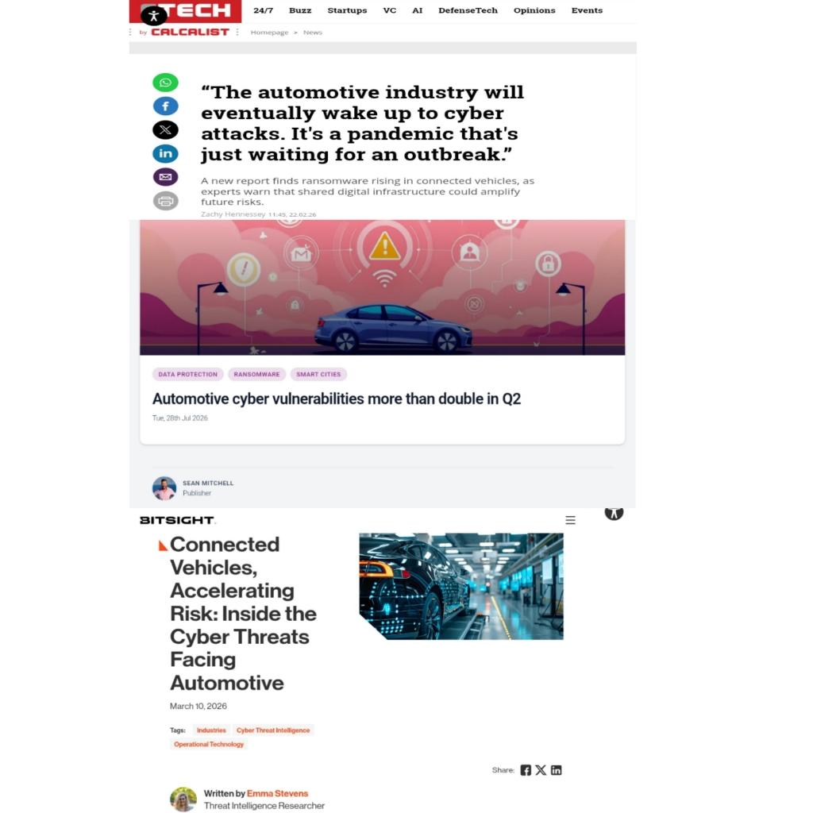
3. Evidence and Context
Evidence and Industry Context
High-profile attacks, such as the 2015 remote hijacking of a Jeep Cherokee's braking and steering, prove that in-vehicle network vulnerabilities are a critical safety risk.
The architecture addresses the rigorous requirements of the ISO/SAE 21434 standard ("Road vehicles — Cybersecurity engineering") by enforcing data confidentiality and mitigating emerging threats.
The integration of ML-DSA directly aligns with the recent NIST FIPS 204 standard for post-quantum digital signatures.
Current research highlights the lack of post-quantum payload handling in standard protocols; our simulated CAN-FD block-transfer mechanism directly solves this documented gap.
Secure IoV Literature Review
03 / 10

Slide 4
4. Methodology
Step 2: Gateway-Side Intrusion Detection
The system prepares structured time-series features from decrypted telemetry and message behavior.
A lightweight anomaly-detection model runs locally on the Gateway to flag malicious traffic without relying on encrypted payloads.
Federated Learning aggregates model updates across a simulated multi-vehicle fleet, keeping raw telemetry strictly local.
Proposed Methodology
Step 1: Network Architecture and Cryptography
The architecture divides the network into functional domains connected by a Central Gateway and establishes device trust using reconstructed device-root secrets.
The Gateway initiates startup with a fresh challenge, and the ECU responds with a post-quantum attestation signature.
The system slices large attestation objects into fragments, transmitting them with ordering and status indicators across CAN-FD frames.
The framework wraps all runtime telemetry using authenticated encryption, applying replay protection and sender identity validation.
Step 3: Integrated Evaluation
The project validates the complete software lifecycle from authenticated startup to local intrusion detection inference.
It profiles system performance by measuring CPU, memory, and latency overhead to provide concrete comparative benchmarks for publication.
04 / 10

Slide 5
PAPER 01 / RESEARCH GAP
PQC • ECU • OTA
Post-Quantum Cryptography for ECU Security Use Cases
WHAT THE PAPER ENABLES
WHERE IT STOPS
RESEARCH GAP
• Shows PQC signatures are practical on constrained automotive microcontrollers.
• Identifies Dilithium as a strong performance/security candidate for secure updates.
• XMSS requires strict state management and limits signatures per key.
• No AES hardware acceleration; XMSS hashing was slower than optimized implementations.
Validate PQC under real-time CAN constraints and assess integration with EVITA-compliant hardware security modules.
CAPSTONE LINK
Benchmark quantum-safe authentication on real or hardware-in-the-loop automotive gateways.
05 / 10

Slide 6
PAPER 02 / RESEARCH GAP
PQC • CAN • SIMULATION
PQ-CAN: Simulating Post-Quantum Cryptography in Embedded Systems
WHAT THE PAPER ENABLES
WHERE IT STOPS
RESEARCH GAP
• Scalable, modular test environment with adjustable CPU and CAN bit-rate constraints.
• Makes security-strength, latency, and delivery-success trade-offs explicit.
• Software-only simulation; no validation on physical CAN hardware or legacy ECUs.
• Large keys/signatures caused latency and timeouts under heavy traffic.
Extend PQ-CAN to physical networks and optimize algorithms that miss time-sensitive automotive deadlines.
CAPSTONE LINK
Use simulation for selection, then verify chosen primitives on a gateway testbed.
Secure IoV Literature Review
06 / 10

Slide 7
PAPER 03 / RESEARCH GAP
QFL • IDS • FLEET
Quantum Federated Learning for Autonomous Vehicle Cybersecurity
WHAT THE PAPER ENABLES
WHERE IT STOPS
RESEARCH GAP
• Addresses non-IID learning, privacy, Byzantine clients, and quantum-era interception together.
• Quantum distance estimation promises fleet-scale filtering beyond classical Krum.
• QKD point-to-point links are unsuitable for frequent V2V broadcasts and suffer attenuation.
• Architecture is theoretical; energy and latency are not measured on automotive hardware.
Build hardware-in-the-loop validation joining real ECUs, automotive traffic, and accessible NISQ-era quantum resources.
CAPSTONE LINK
Retain federated/behavioral IDS ideas while grounding security in deployable gateway hardware.
Secure IoV Literature Review
07 / 10

Slide 8
PAPER 04 / RESEARCH GAP
PUF • KYBER • DILITHIUM
Lightweight Cryptography + PQC + PUFs for In-Vehicle Communication
WHAT THE PAPER ENABLES
WHERE IT STOPS
RESEARCH GAP
• Combines hardware identity, quantum resistance, lightweight AEAD, and network segmentation.
• Offloading keeps resource-constrained ECUs viable with low communication overhead.
• One ProVerif identity query remains unresolved; authentication occurs only at startup.
• No physical automotive benchmark, continuous monitoring, or explicit per-message freshness.
Authenticated ECUs may become malicious after startup; continuous runtime behavioral detection is missing.
CAPSTONE LINK
Add a lightweight gateway IDS using timing, frequency, spoofing, flooding, and communication patterns.
Secure IoV Literature Review
8 / 10

Slide 9
PAPER 05 / RESEARCH GAP
LSTM • CONTEXT • CAN
Intrusion Detection System for Controller Area Network
WHAT THE PAPER ENABLES
WHERE IT STOPS
RESEARCH GAP
• Context-aware evidence reduces false positives and separates benign anomalies from attacks.
• Timing-aware resistance forces attackers to manipulate several correlated signals.
• Limited manufacturers/features; some datasets could not support robust function construction.
• No authentication/cryptography integration; evaluation uses only sensitivity and specificity.
Evaluate behavioral IDS alongside authenticated, encrypted, and post-quantum-secured CAN gateways.
CAPSTONE LINK
Use cryptography for trust establishment and LSTM monitoring for post-authentication compromise.
Secure IoV Literature Review
9 / 10

Slide 10
PAPER 06 / RESEARCH GAP
SURVEY • IVN • FUTURE
IDS for In-Vehicle Networks: Protocols, Applications & Challenges
WHAT THE PAPER ENABLES
WHERE IT STOPS
RESEARCH GAP
• Comprehensive protocol-to-IDS view with future technology directions.
• Connects detection accuracy to practical deployment and migration constraints.
• Real-world datasets are limited and heterogeneous.
• Large models and computationally intensive PQC exceed many current ECU capabilities.
Backward-compatible migration needs lightweight AI, secure gateway inference, PQC authentication, and hardware acceleration.
CAPSTONE LINK
Centralize PQC and IDS at an intelligent gateway while preserving legacy ECUs.
Secure IoV Literature Review
10 / 10

